Slide 1

Everything That You Want
Don't stop living in the rest.. Discover something new.. Experience the lifestyle

Slide 2

Members:-
Avika Sharma (Team Leader)
Gurden Singh
Manya Gupta
Utkarsh Pathak
Vyom Aggarwal

Slide 3


Slide 4

About MARTIFY
MARTIFY is a team of passionate professionals bringing earning opportunity to common man across India. MARTIFY has created a model combining digital technologies , direct selling and retailing This business bring high quality products within customers reach.
It has created employment and ease at shopping online at the same time.
Both the vendor and customer can have direct exchange of goods at cheaper price though our website.

Slide 5
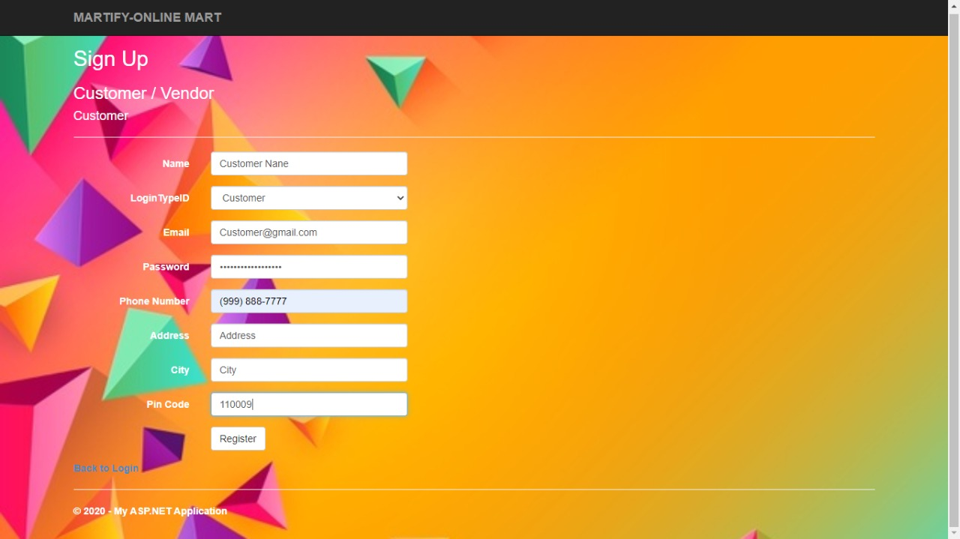
THE SIGNUP Page

Slide 6
THE SIGNUP PAGE
The new customers will have to sign up using website www.martify.com on their search engine .Then they will be able to see the sign up page .
The vendors interested too can signup using the same website.
As we can seen in the above picture SIGNUP page after the name ask for the LOGIN ID TYPE.
This ID feature have two option one is CUSTOMER and other is VENDOR.
Both the option will required different details for further sign up.

Slide 7
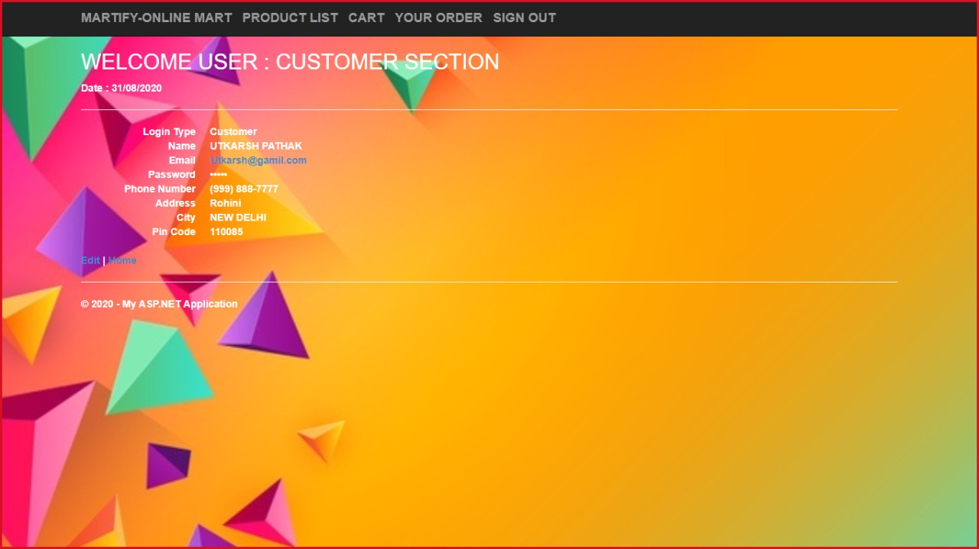
CUSTOMER SECTION

Slide 8
VALIDATION for SIGN UP for both VENDORS and CUSTOMERS.
The name must contain more than 2 letters.
The credentials for email id and phone number should be correct because SIGN UP will be failed if OTP is incorrect.
The age criteria is 18+.
Valid PINCODE should be provided.

Slide 9
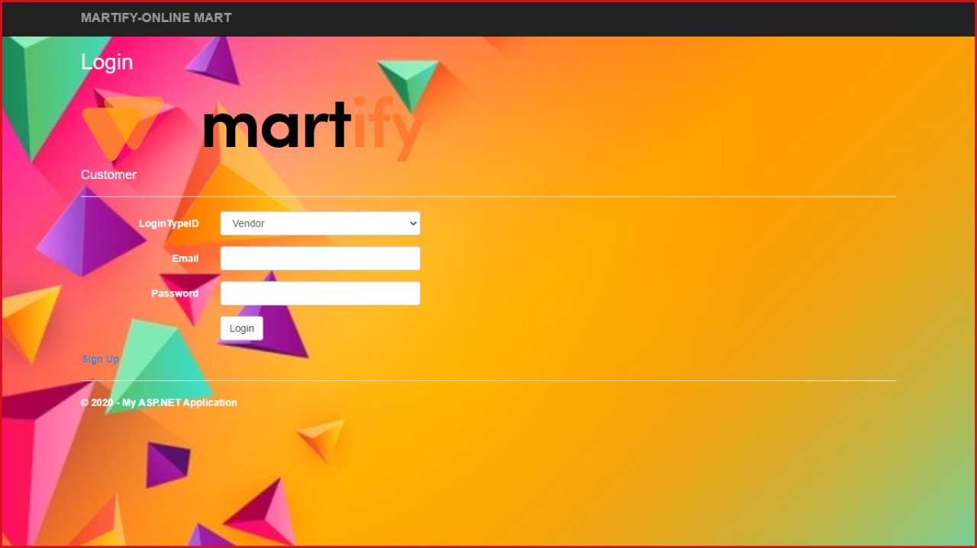
THE LOGIN Page

Slide 10
CUSTOMER LOGIN Page
There is hassle-free login for customer they just have to fill basic information and they can enjoy the joy of e-shopping.
Once registered customers will be directed to the home page where they can see various products available with the better deals for them.

Slide 11
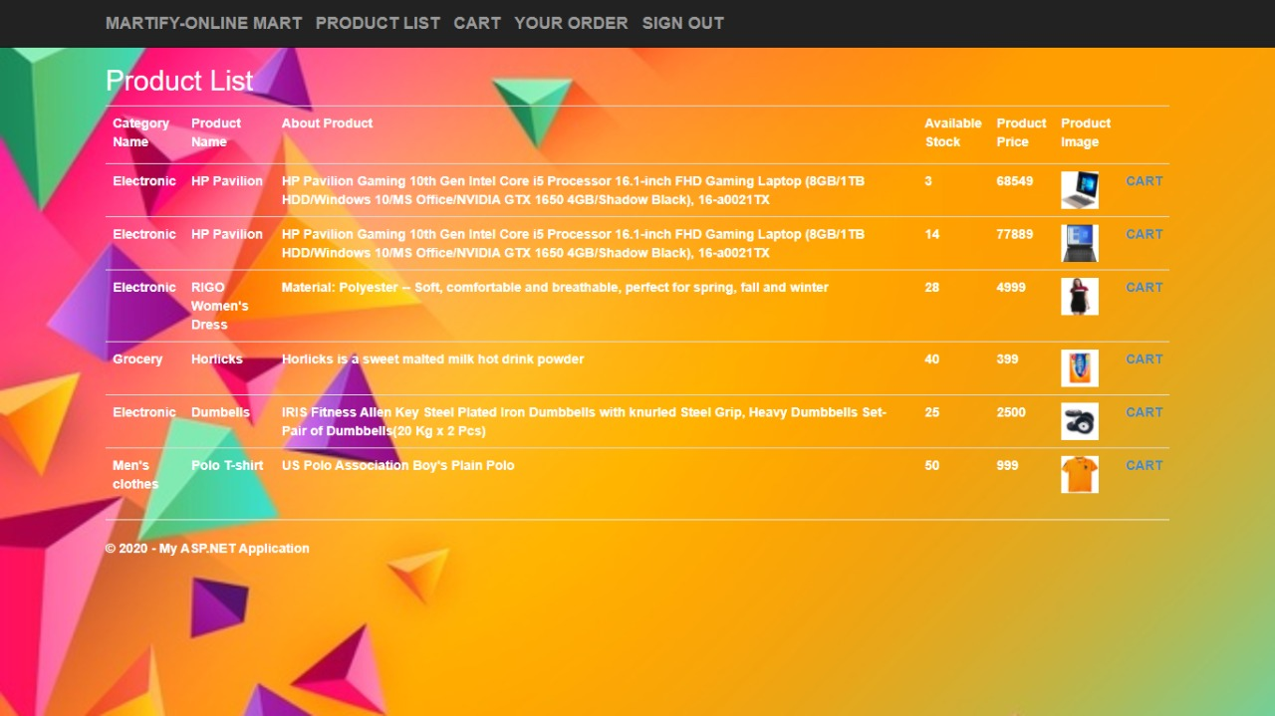
The HOME PAGE after signing up…

Slide 12
HOME PAGE AFTER SIGNUP
Customer can find product list at the home page just after the login.
From here customer can add to cart or can go for categorized list.
Customer can go to cart, order details, can search for desired product.

Slide 13
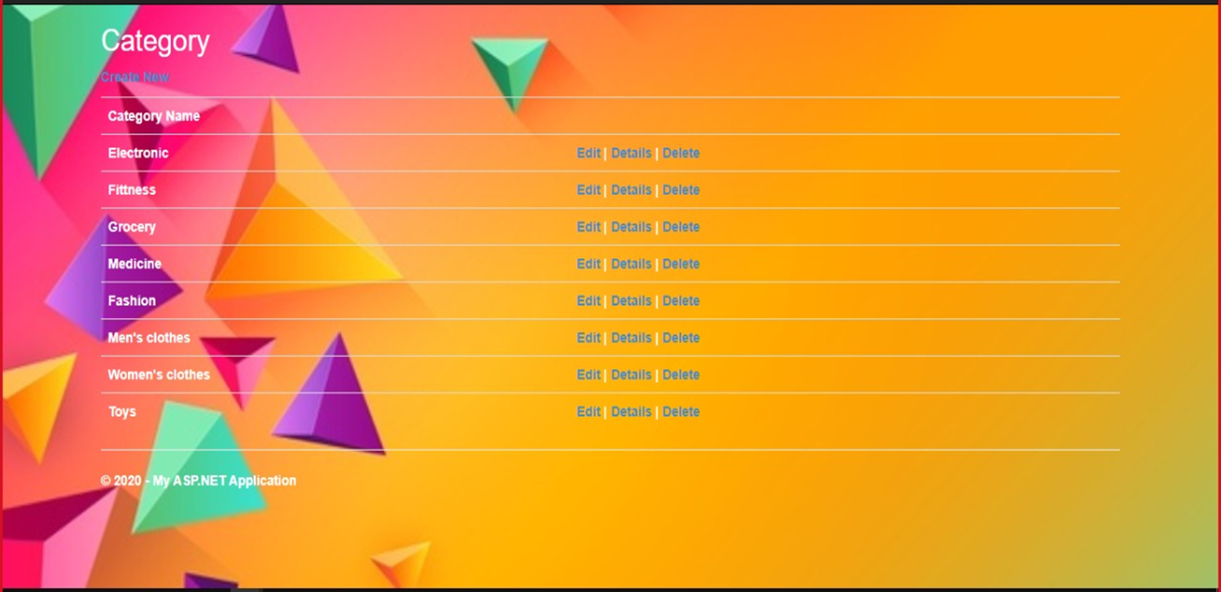
THE CATEGORY PAGE

Slide 14
CATEGORIZED PAGE
They can have the categorized page that will reduce confusion and will give brief details to satisfy different needs of various customers.
The MEN,WOMEN,KIDS,ELECTRONICs etc will have different products for different use accordingly.
Also the size and others needs could be sorted with the SORT BY options for further ease.

Slide 15
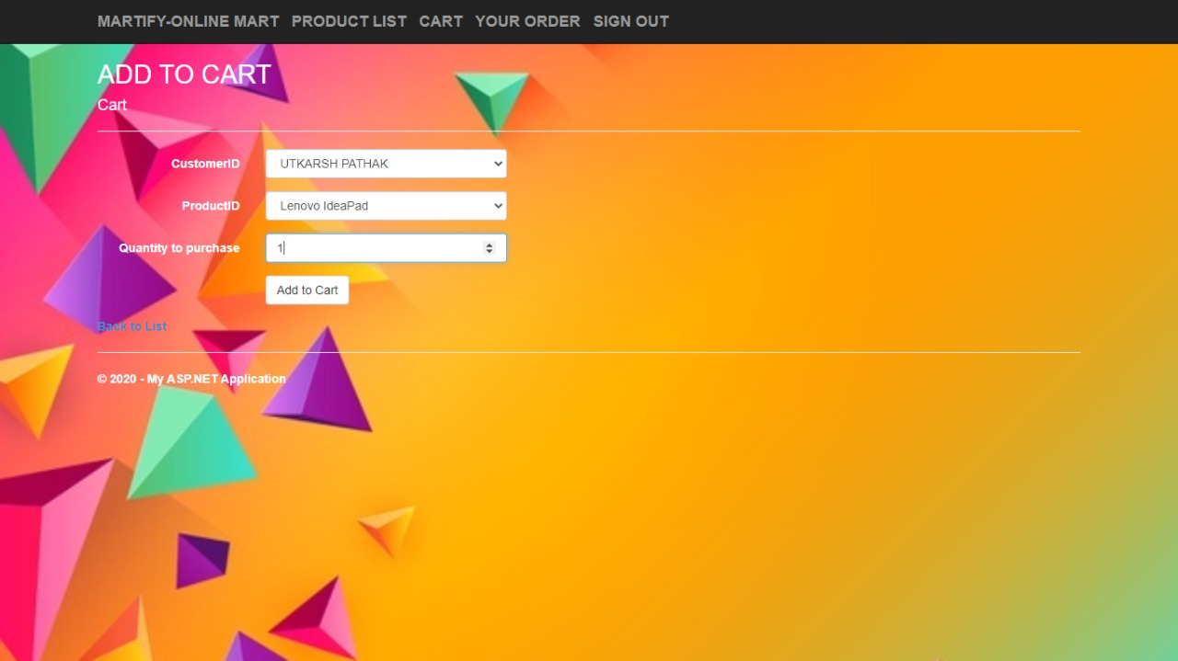
ADD TO CART

Slide 16
ADDING TO CART
Customer will find the product they selected in the cart, where they can checkout after which the order will be placed.
Customer can change the product as well as quantity for the order.
Customer also have facility to change address or any other contact information.
Adding to cart provides customer with review facility so that products are verified before order placement.

Slide 17
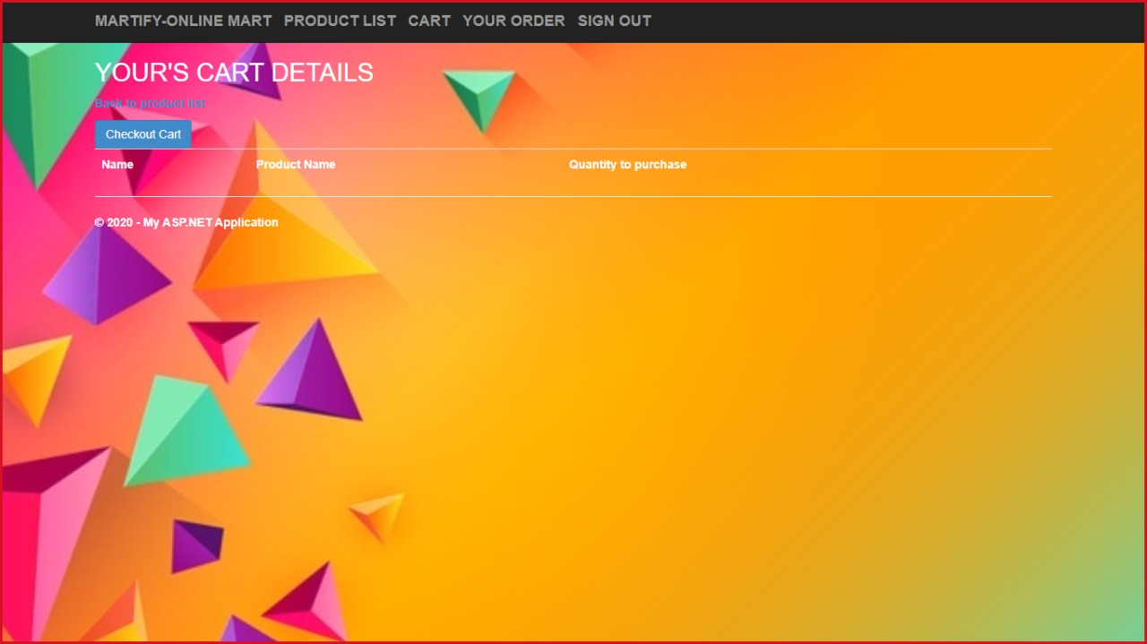
CART DETAILS

Slide 18
CART DETAILS
Here details like products, quantity, total amount is found.
It’s main purpose is to provide facility of reviewing for product .
Customers can easily edit their order list before placing orders.

Slide 19
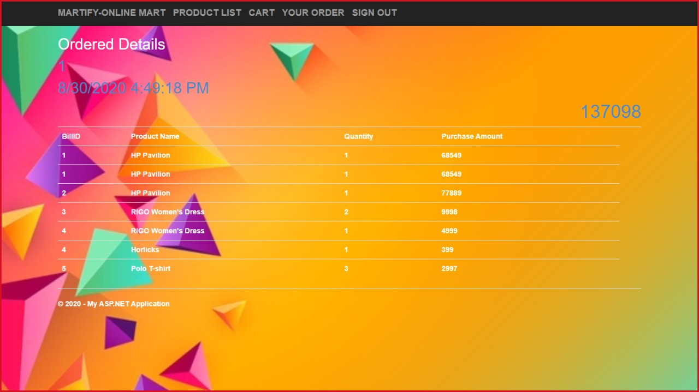
ORDER DETAILS

Slide 20
ORDER DETAILS
Provide customer with information like total amount to pay, products they are placing in order.
It’s like a billing system.

Slide 21
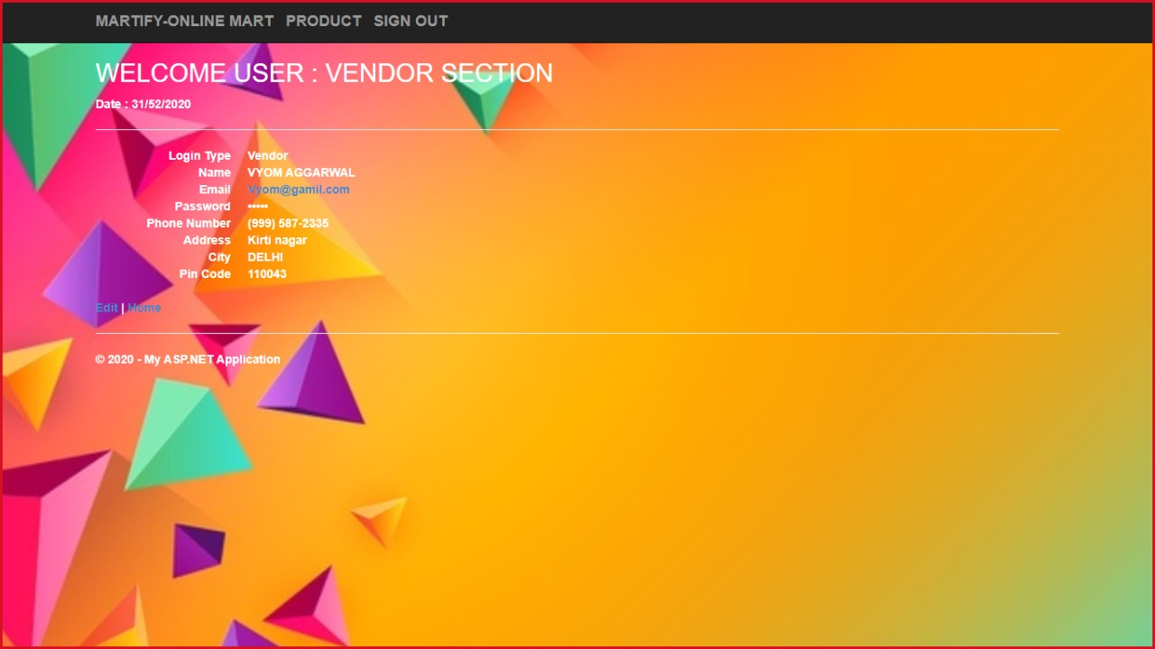
THE VENDORS HOME PAGE

Slide 22
VENDOR’S HOME PAGE
Vendor login page includes their login type and further contact details.
Vendors will find home page at their screen just after login.

Slide 23
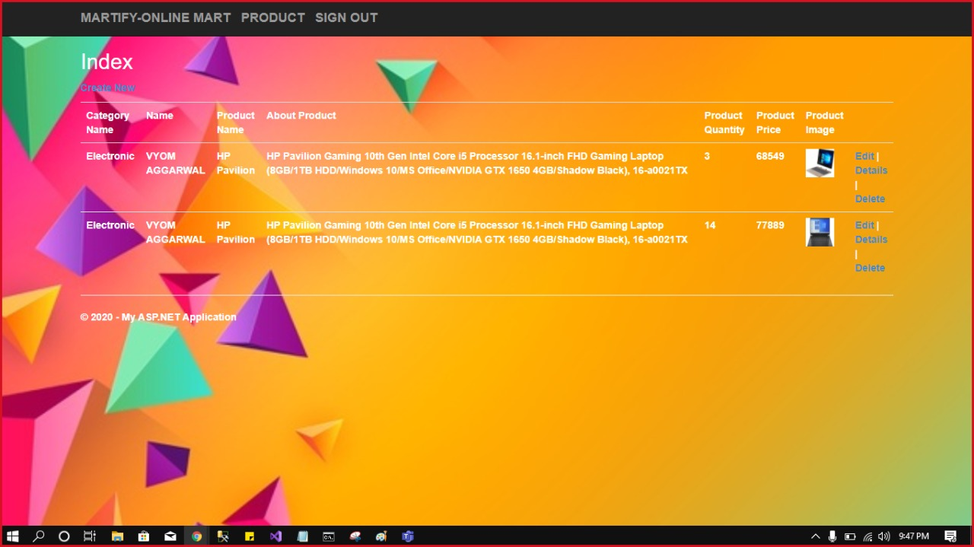
After the login VENDORS are directed to their cart where ,their products are visible.
VENDOR’S CART

Slide 24
VENDOR’S CART
Here vendor can add a product or delete or can edit the existing products.
It is the list of all the items available with the vendor.

Slide 25
THANK YOU

